Slide 1


How the 4 fundamental forces affect flight
mohib

Slide 2
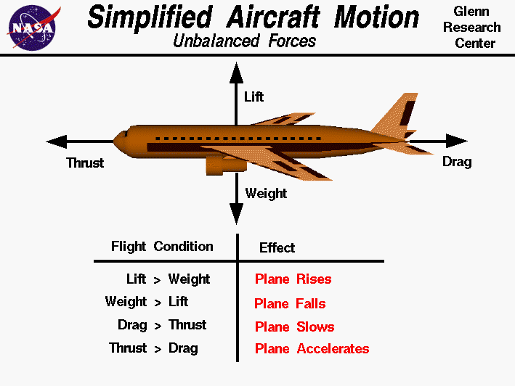
Introduction of the principles behind flight
Aerodynamics is the study of how air interacts with objects in motion, such as airplanes.
Airplane flight is governed by four fundamental forces:
Thrust: A forward force generated by the airplane’s engines, enabling motion.
Drag: A resistive force caused by air resistance acting opposite to thrust.
Lift: An upward force generated by the wings, enabling the airplane to counteract gravity.
Weight: The downward force due to gravity acting on the airplane’s mass.
Stable flight requires a balance of forces:
Thrust must overcome drag.
Lift must balance weight.

Slide 3
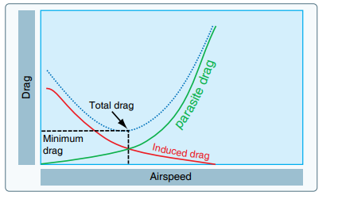
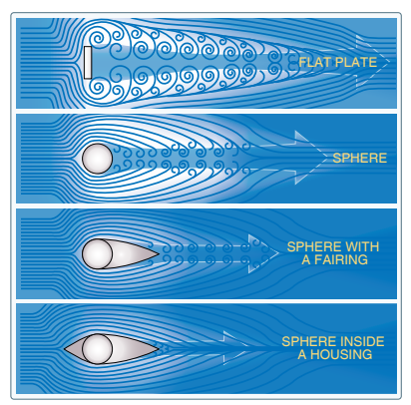
Thrust and drag
Thrust:
Generated by propulsion systems, such as:
Jet engines for high-speed, long-distance efficiency.
Turboprop engines for slower speeds and fuel-efficient regional flights.
Piston engines in light aircraft, using propellers for forward force.
Follows Newton’s Third Law: Expelling air or exhaust backward generates an equal forward reaction force.
Drag:
Resists forward motion and opposes thrust, slowing the airplane.
Two main types:
Parasite Drag:
Caused by air resistance on non-lifting parts (e.g., fuselage, landing gear).
Increases exponentially with speed and reduced through smoother, streamlined designs.
Induced Drag:
Results from lift generation, creating wingtip vortices and energy loss.
Most significant at low speeds (e.g., take-off, landing).
Mitigated using winglets to reduce vortices and enhance fuel efficiency.

Slide 4
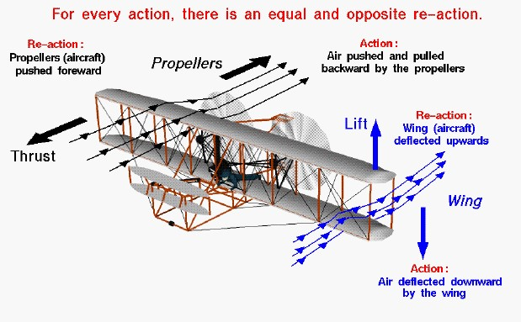
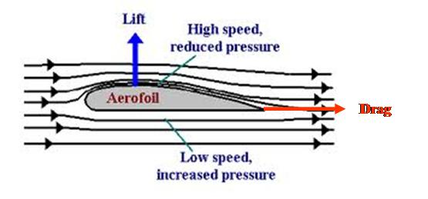
Lift and weight
Lift:
Generated by the wing's airfoil shape (curved top, flatter bottom).
Bernoulli’s Principle: Faster airflow over the curved upper surface lowers pressure, while slower airflow beneath creates higher pressure, generating lift.
Newton’s Third Law: Downward deflection of air by the wings creates an equal upward force.
Weight:
Downward force due to gravity, calculated as W=mg (gravity = 9.81 m/s²).
Acts through the center of gravity, where the airplane’s mass is balanced.
Changes during flight as fuel burns, requiring pilots to adjust for stability and control.

Slide 5

Summary of all principles
Newton’s Laws:
First Law: Stable flight occurs when forces (thrust, drag, lift, weight) are balanced.
Second Law: Heavier planes need more force to accelerate
Third Law: Wings deflect air downward, creating an equal upward lift force.
Bernoulli’s Principle: Faster airflow over the wing’s curved top reduces pressure compared to slower airflow below, creating lift.
Continuity & Energy: Air accelerates over wings to maintain constant flow, while energy conservation ensures efficient lift.

